Slide 1
API and Python training
Session 8

Slide 2
This session’s agenda
SDKs – Software Development Kits
Using SDKs in Python
SDK examples
Building simple API server
Recap from Session 1 – Controllers
Northbound and Southbound APIs
Intro to Flask
Defining routes
Returning JSON data
Reading data from files
Filtering data - List comprehension
Next steps

Slide 3
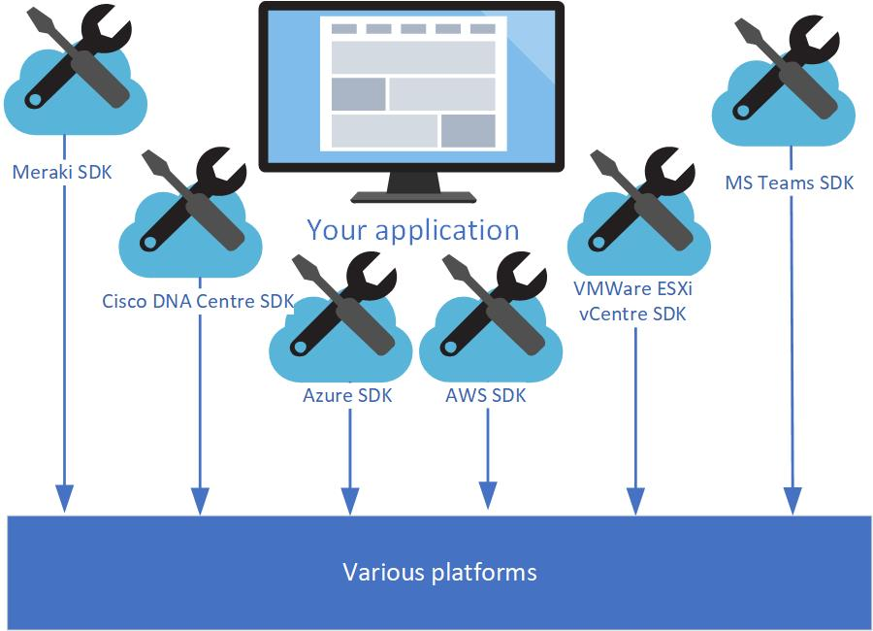
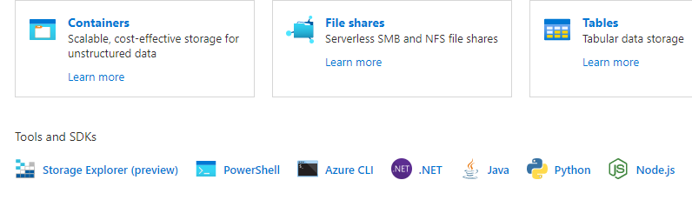
SDK – Software Development Kit
A software development kit (SDK) is a set of software tools and programs provided by hardware and software vendors that developers can use to build applications for specific platforms. These providers make their SDKs available to help developers easily integrate their apps with their services.
SDKs ‘hide’ the complexity of handling underlying API, providing ready to use ‘building blocks’
Most software and hardware have SDKs available – when you start working with a product/platform, check if there an SDK is available
Most SDKs are open-source, so check the code
Use it where available/possible – greatly simplifies the development process, allow you to consume the service and focus on application logic rather than on platform implementation details or API version
Example: Azure Storage SDK
https://whatis.techtarget.com/definition/software-developers-kit-SDK
https://github.com/Azure/azure-sdk-for-python/tree/master/sdk/storage/azure-storage-blob

Slide 4
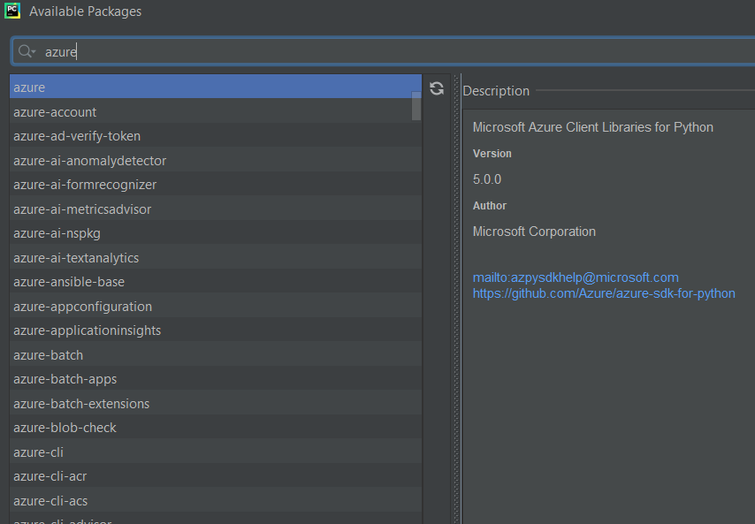
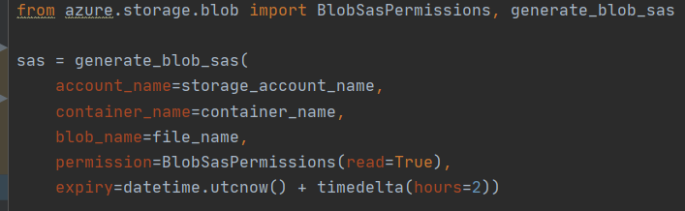
SDKs in Python
SDKs for Python are normally libraries installed and imported
As usual, install with pip or IDE ---------->
And import in the code:
Compare with using Azure REST API:
Example using Azure blob storage SDK:
https://docs.microsoft.com/en-us/rest/api/storageservices/service-sas-examples
https://github.com/supro200/sdwan-auto-upgrade

Slide 5
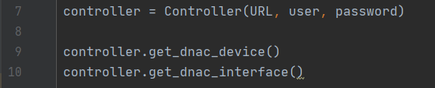

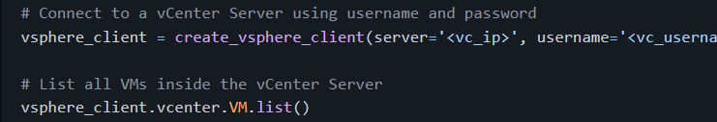
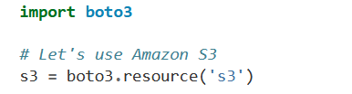

SDKs examples
During our recent sessions we already built a simple SDK
Compare with Real Cisco DNA SDK, should be similar ☺
https://blogs.cisco.com/developer/using-cisco-dna-center-sdk
Other examples:
Meraki SDK - https://developer.cisco.com/meraki/
Vmware SDK:
https://github.com/vmware/vsphere-automation-sdk-python
AWS SDK
https://boto3.amazonaws.com/v1/
documentation/api/latest/guide/quickstart.html

Slide 6

Looking at REST API from different side:
Building API Server

Slide 7
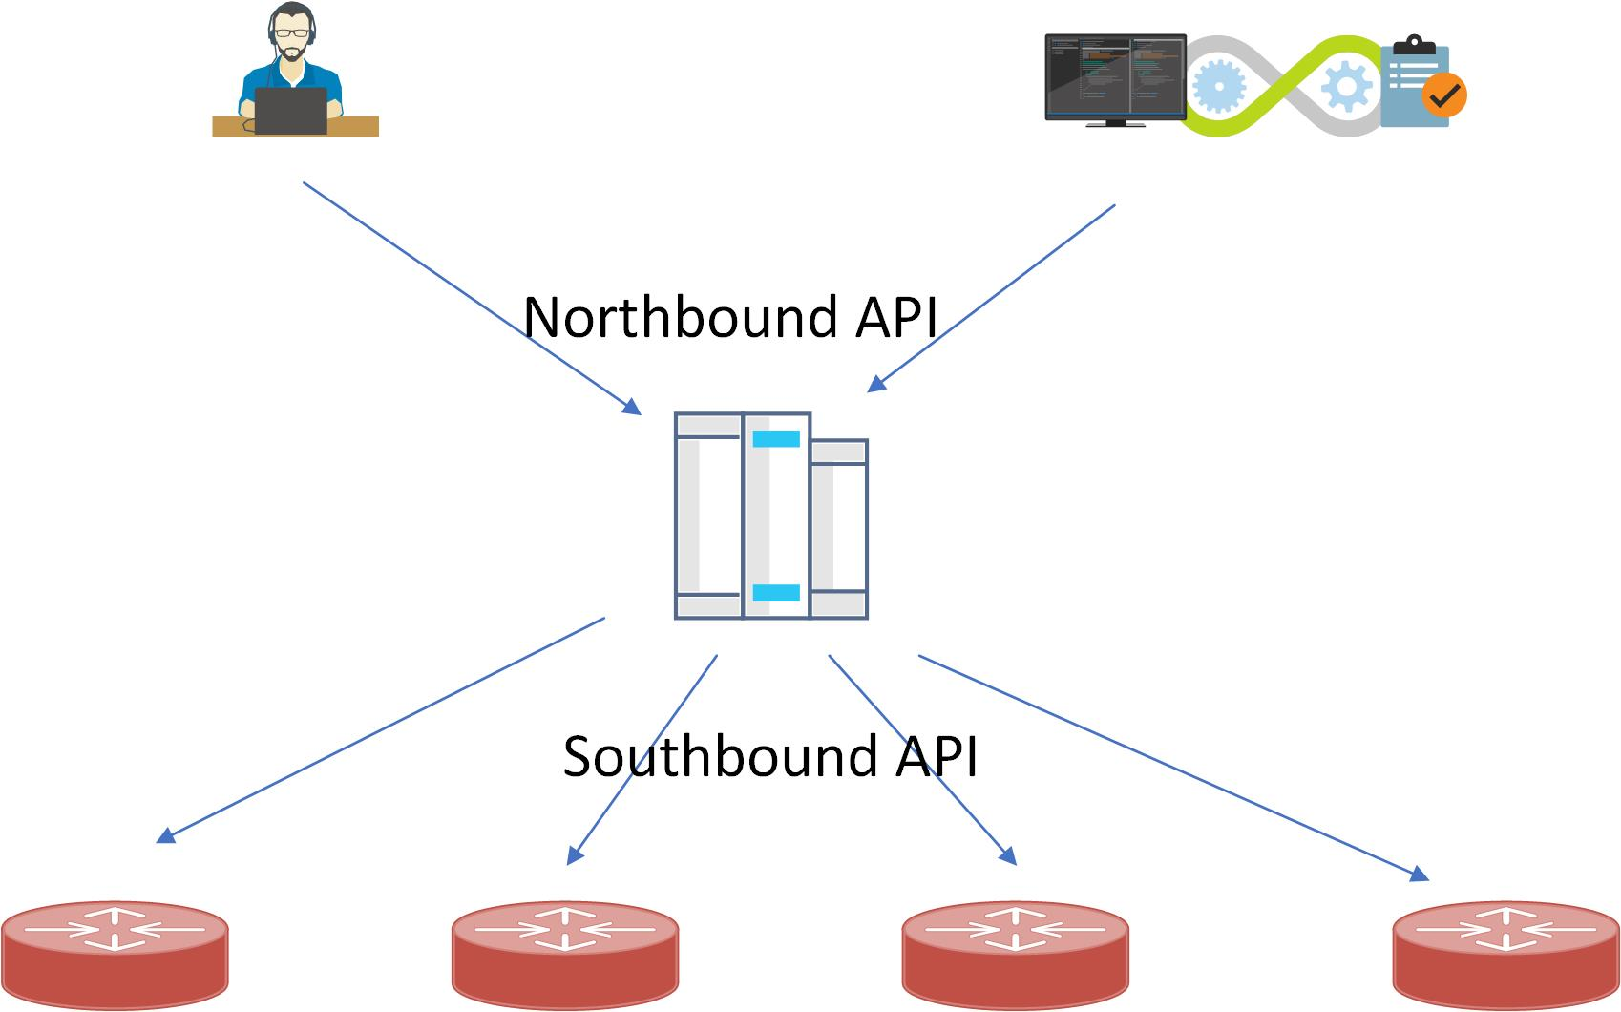
Recap from session 1 - Controllers
Remember session 1 ?
Controllers offers consumable API, doing authentication, RBAC, etc. This type of API exposed to be used is called northbound API.
Controllers maintain connections to identify the operational state of controlled devices, push configuration, pull logs. Controlled devices also can push alerts, state changes. This type of comms is called southbound API. This API can be proprietary, maybe even SSH or SNMP.
Example of controllers:
Cisco vManage NSX Manager Kubernetes Master
Philips Hue Lighting Google Smart Home
Public clouds also provide API endpoints to control resources, so they can be also considered as controllers to some extent.

Slide 8
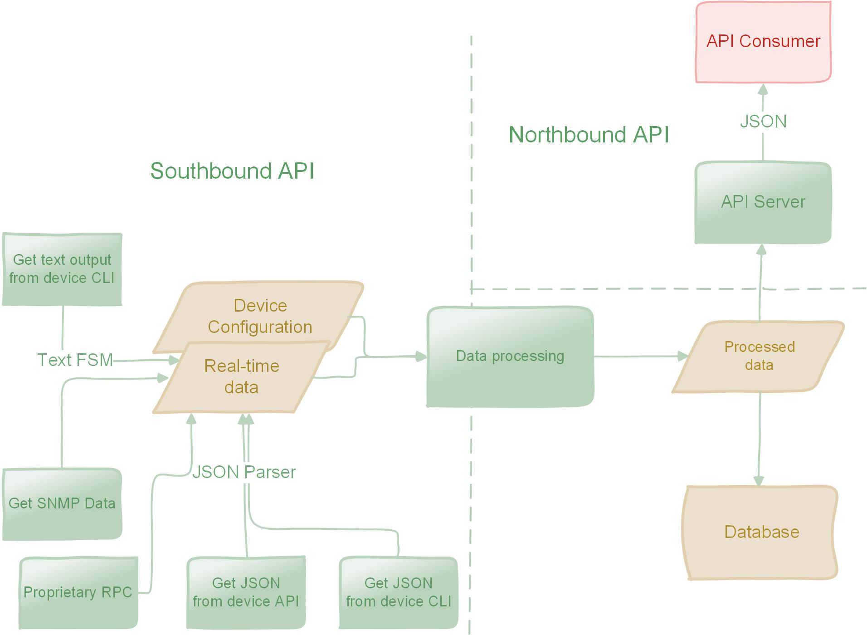
Southbound vs Northbound API
Southbound API is to talk to specific vendor devices and can be any, for example:
- SSH
- Netconf
- RESTConf
- Any proprietary RPC – Remote Procedure calls
- SNMP
When the controller gets data from the devices it processes it, can store the raw and/or processed data in a database and presented to the API consumer
We’ll build simple Northbound API using pre-processed data in CSV format
REST API server is essentially a lightweight web server

Slide 9
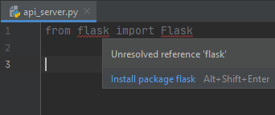
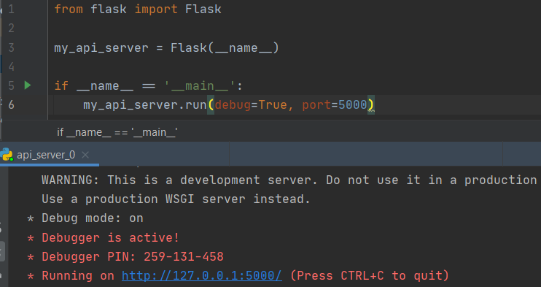

Flask – getting started
There are many web frameworks for Python, most popular are Flask and Django
Flask is a lightweight, easy to use, good documentation and community support
To get started, install flask package using pip
or simply with IDE -------->
Minimal code to run the server is ---------->
Note you can specify the port
debug=True mean you can change your code and don’t need to restart the server, it will detect the changes when you save the file and restart automatically – convenient while you’re developing
By default, it only accepts connections from localhost, to override it, use parameter host=‘0.0.0.0’ (or whatever network you originate requests from)
Refer to the doc for full description
Then test with CURL, and get 404 – Not Found which means the server is running, but there are no routes, as expected
https://flask.palletsprojects.com/en/1.1.x/quickstart/

Slide 10
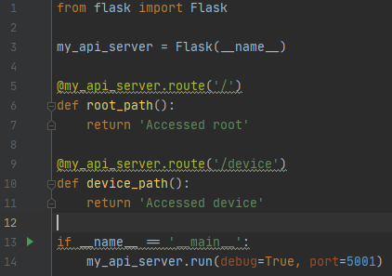
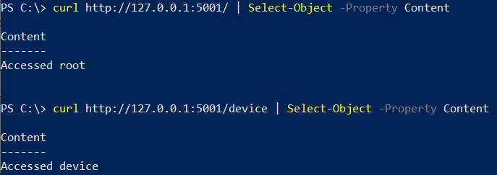
Flask routing
Add routes using decorators - @
Decorators are in fact functions which are called immediately before the function defined next
In flask we use decorator route with parameter of path
In next line define the function which will implement the application logic
In return statement you return the API response body
<flask_object>.route(<path>)
def <your function name> ():
code…….
return <something to return in API response>
Make API call again using resource/path ----------->

Slide 11
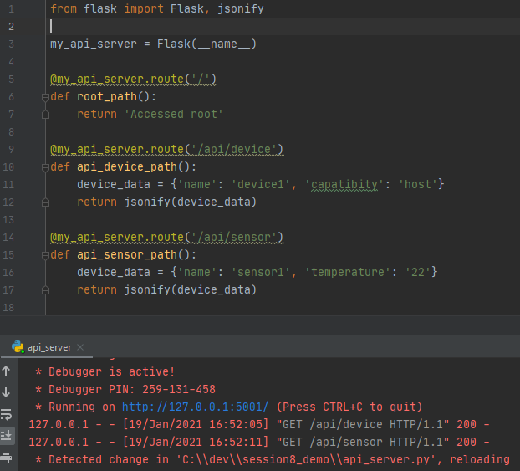
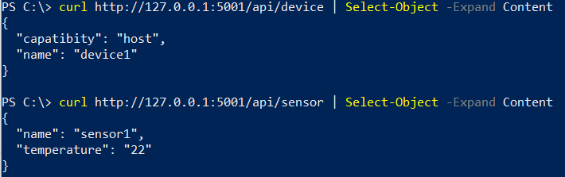
Flask – returning JSON
In API response you normally expect data in JSON format
You can send the text string in as JSON
Alternatively, Flask has embedded function jsonify which coverts Python dictionary to JSON string
Define the dictionary and supply it as a parameter to jsonify function Lines 11-12 and 16-17
Change path to /api/<resourse> to look more professionally ☺
Make API call again using resource/path ------>

Slide 12
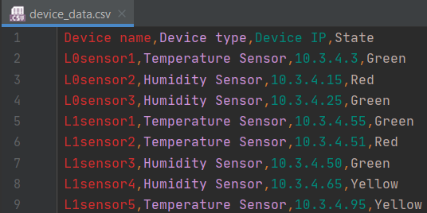
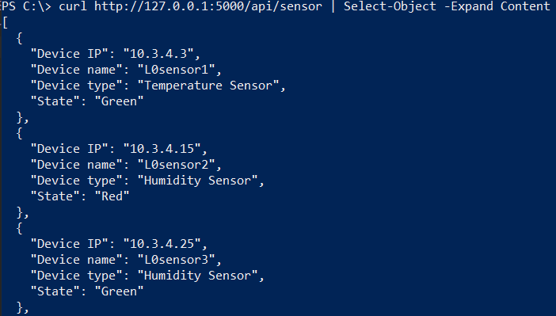
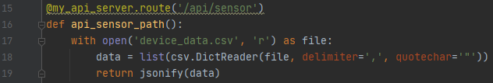
Reading from CSV files
We’ll use pre-processed data to return in API response
Python has standard CSV module (which means you don’t need to install it using pip)
CVS file with some example data ---------->
How to read data from the file:
Line 17 – open file, this is the recommended way of working with filesystems
Line 18 – uses cvs module standard function DictReader to convert CVS to Python dictionary using headers as keys
Line 19 – convert dictionary to Python string
Make API call again using resource/path,
receive the data in JSON format --------->
If you’re using Windows powershell:
curl http://127.0.0.1:5000/api/sensor | Select-Object -Expand Content

Slide 13
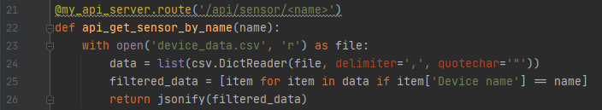
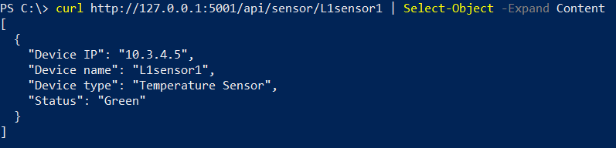
Using variables in URL
In Flask routes you can use variables, and pass these variables as parameters to a function
Add a new route with variable in <>
Line 25 – List comprehension – build a new list from another list using conditions, there are 3 parts:
- item – takes the element from the original list to the new list
- for item in data - iterate though the list data
- if item['Device name'] == name - for the element taken from the list (element here is a dictionary), compare if value of key Device name matches the requested value
Make API call again
using resource name ------>

Slide 14
Demo

Slide 15
Summary and next steps
Summary
SDK
Flask
Next time – Final session
Open API specification/Swagger
Connexion module
Training summary

